Slide 1
Corporate Presentation

Slide 2
Water, a key sector
Huge market: 400 to 500 Billion € turnover /year
(drinking and waste water)*
Considerable assets: > 3.5 Million Km water distribution pipes
> 2.5 Million Km waste water sewers
Large social impact: > 600,000 direct jobs in Europe
EU annual Investment: €10,5 Bn for water and wastewater equipment for industrial markets
€33 Bn invested in water infrastructures
SMEs: 136.000 employees, 9.000 SMEs
* Source: Deutsche Bank

Slide 3
Key facts on WssTP
European Technology (and Innovation) Platform
Strives to:
  Improve coordination and collaboration in RTD & Innovation
  Enhance competitiveness of the European Water Sector
  Contribute to solving societal challenges through RTD & Innovation
Membership-funded ETP
  Legal entity
  Growing organization: From 11 to 100 members from 2008 to 2013
  Openness and transparency: 315 contributing organization, a network of more than 750 persons
Strategic recommendations and working groups: 3 key documents (SRA, Vision document, Implementation document), many scientific reports sent to DG Research
Yearly stakeholders’ event: www.waterintheurbanenvironment.eu
Originated ACQUEAU, the EUREKA Cluster for water

Slide 4
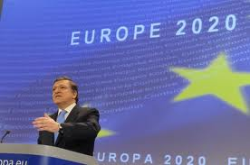
A changing environment
2004
2006
2007
2010
2011
2012
2014
WssTP initiated by EC
WssTP Water Vision
WssTP SRA 1st
WssTP SRA 2nd
Expansion WssTP staff
Launch EIP Water
ETP 2020
WssTP becomes a legal entity
EU2020 strategy
Horizon 2020
Regional policy 2020
Launch FP7
Initiation ACQUEAU
………….
5 EU targets for 2020
  Employment
  R&D/innovation
  Climate change/energy
  Education
  Poverty/social exclusion

Slide 5
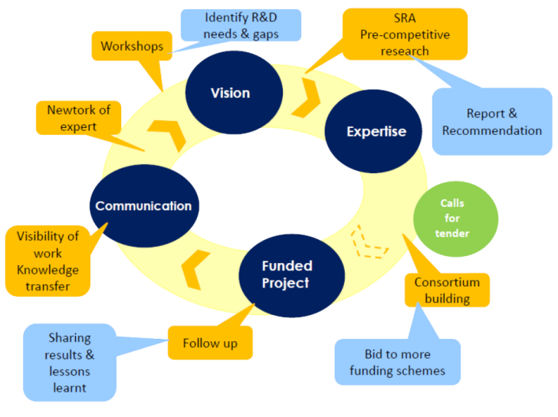
A changing environment

Slide 6
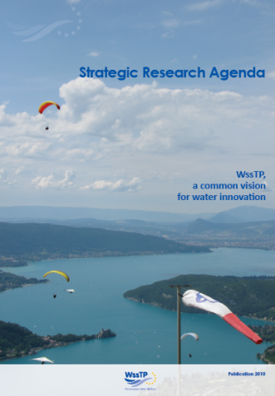
Global drivers in SRA 2010
Water: a necessary but low cost good
Demographic growth and urbanisation
Increasing globalisation and wealth
Spatial and temporal pressure
(coastal urbanisation, tourism)
Global warming

Slide 7
Major Challenges in SRA 2010
Coping with increasing water stress
(quantity & quality)
Reducing impact of extreme events
(droughts and floods)
Managing aging or lacking
infrastructure
Facilitating technology transfer
Establishing an “Enabling Framework”
The MDGs for Sustainable Water Supply and Sanitation Services
in Developing Countries

Slide 8
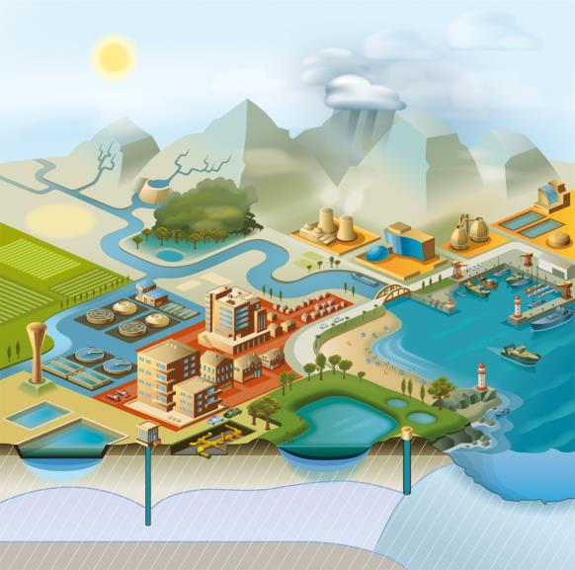
Address research and innovation based on the water cycle
Extreme events
Industry
Agriculture
Degraded zones
Urban Areas
Coastal Zones

Slide 9
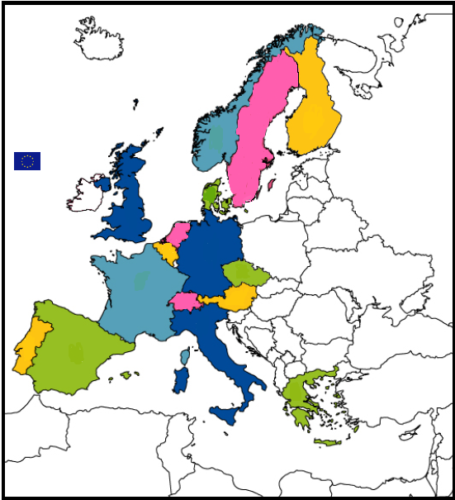
WssTP, a growing organization!!
1
1
6
3
4
13
14
6
4
1
WssTP membership colleges:
College A: Multinational corporations
College B: Research & Technology developers
College C: Utilities
College D: Suppliers & SMEs
College E: Large water users
9
2
3
23
6
1
2
2

Slide 10










WssTP Members
Industrie and SME’s

Slide 11
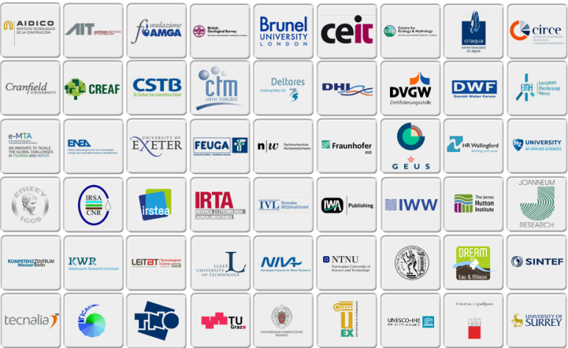




WssTP Members
Academics & Research

Slide 12
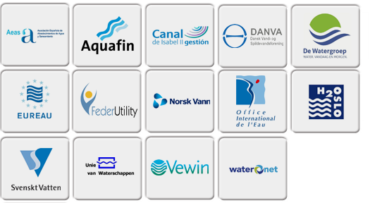
WssTP Members
Utilities

Slide 13
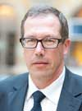
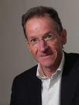
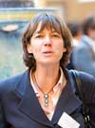
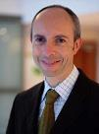
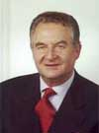
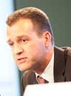
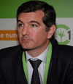
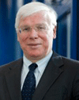
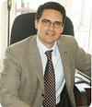
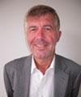

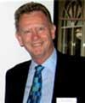
WssTP Board Members
Tomas Michel
Chair
Suez
Theo van den Hoven
Vice Chair
KWR
Marie-Renée de Roubin
Treasurer
Veolia
Philippe Bréant
Veolia
Alain Rousse
UIE
Boris Lesjean
KWB
Arturo Buenaventura
Abengoa Water
Theo Schmitz
Vewin
Carlos Campos
Suez
Dirk Van der Stede
VLAKWA
Jens Prisum
EUREAU
Mike Farrimond
Inmediate Past President

Slide 14

Services to members
Bringing actors together from all aspects of the EU water sector through a variety of activities and our working group structure
Further elaboration of the RTD&I state of the art and needs of specific topics resulting in specialist reports and presentations
Discussions with the EC to make sure that the RTD&I needs we identify are reflected in the call for proposals for EU funding
Strategic policy work to make sure that the European policy and funding framework is as beneficial as possible to the RTD&I and the competitiveness of the EU water sector
Water value chain cooperation

Slide 15

Services to members II
Organization of brokerage events for calls for proposals for EU funding
Support to project to project consortia that are in line with WssTP Vision and SRA and involve members
Participation to project consortia for communication and dissemination of project activities and results.
Monthly internal and external newsletter
Tailored membership services

Slide 16
WssTP Working Groups
Working Group | Lead Member | Lead Person
Financing for EU Competitiveness | Abengoa Water | Arturo BUENAVENTURA
Water & ICT | Suez | Pascal BLANC
Water-Energy-Food biodiversity nexus | Deltares | Jaap KWADIJK
International Relations | UNESCO-IHE | Gaetano Casale
Water in industry | TNO | Albert Jansen
Resource Recovery | Wetsus | Martijn Bijmans
Membrane Technologies | EMH | Gilbert Rios
Emerging Compounds | Deltares | Harm DUEL
Urban Water Pollution | KWR | Adriana HULSMANN
Bathing Water | KWB | Ulf MIEHE
Agriculture & Irrigation | IRSA | Antonio LOPORTO
Eco-systems Services | Poledream | Gaëtane SUZENET
Green Infrastructure | Deltares | Johan BOON
Managing HydroClimatic Extremes in a changing Environment | CEH | Alan JENKINS
Shale Gas | Veolia | Bruno TISSERAND
Techwatch | KWR | Theo VAN DEN HOVEN

Slide 17
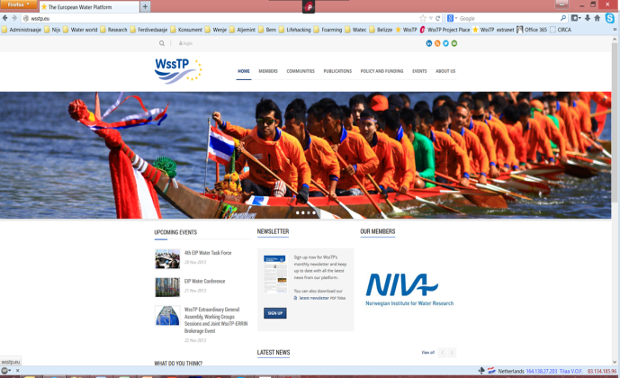
Web services

Slide 18
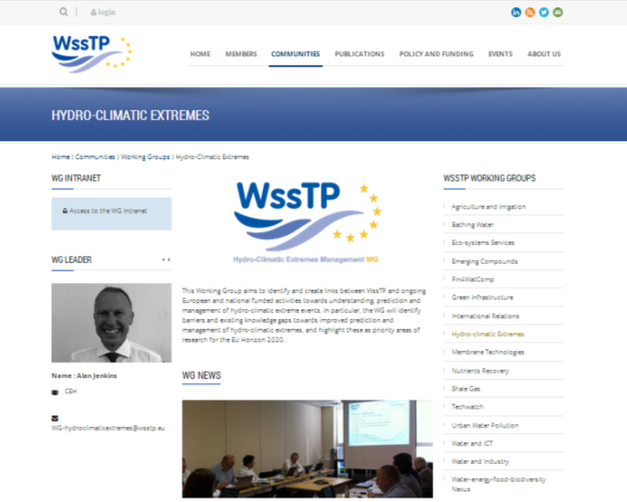
Web services

Slide 19
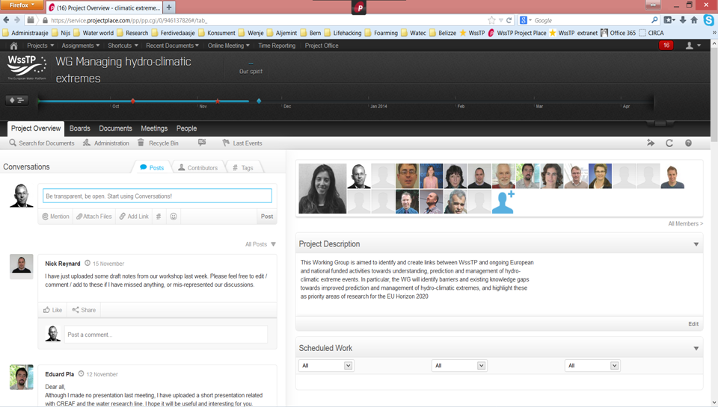
WssTP project place

Slide 20
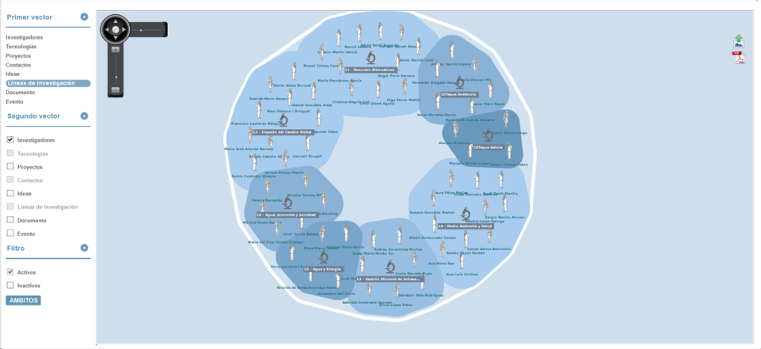
Web Services

Slide 21


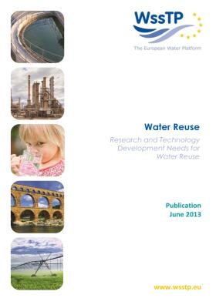
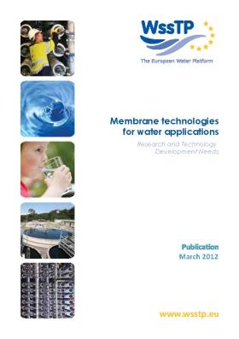
WssTP Publications

Slide 22
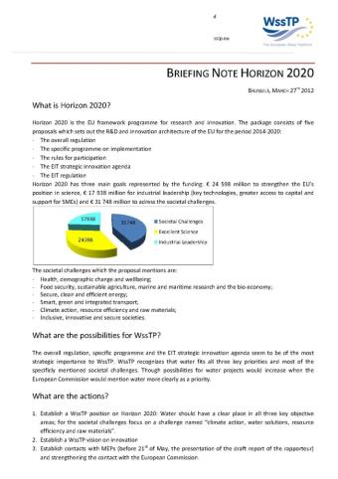
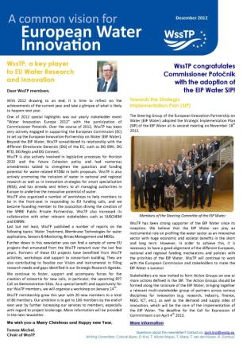
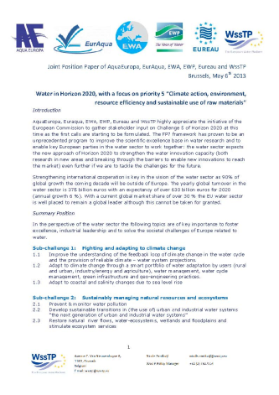
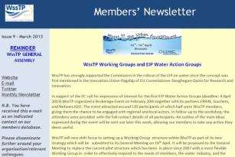
Communication of the WssTP

Slide 23







Examples of research projects supported and/or inspired by WssTP (FP6 & FP7)
Techneau → drinking water
AquaFit4Use → industrial water recycling
Prepared → adaptation to climate change
Trust→ sustainable urban water systems
ChemWater → membrane for water technologies
NetSoc → ICT in water
Saph-Pani → cooperation with India
Water4Energy → water & energy management in industry
Demeau → emerging pollutants
P-Rex → phosphorus recovery from wastewater

Slide 24
WssTP project statistics
FP7 2013 Inno-Demo call (€50M)
Number of proposals submitted | 133
Proposals rewarded | 11
Total number of consortium members | 1335
Successful consortium members | 168
Overall WssTP consortium members | 54
Successful WssTP Consortium members | 29
Success rate total number of consortium members | 13%
Success rate WssTP consortium members | 54%
Successful consortia coordinated by a WssTP member | 64%
Successful consortia with WssTP members | 91%

Slide 25









Key Dossiers

Slide 26

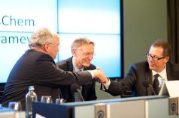
WssTP driver behind EIP Water
t.b.c.
10/05/2012
10/09/2012
17/12/2012
4/4/2013
Announcement
EIP Water
First HLSG
Adoption SIP
Commitment Action Groups
May ‘12
WIE2012 Event contributes to shape EIP Water Commissioner Potocnik adresses WssTP members
Sept/Oct
Active WssTP participation in selection of topics
Nov
WssTP proposals actions taken up by EC
20/2/2013
WssTP & ERRIN workshop icw EC on Action Groups
05/2011
06/2011
10/2011
12/2011
1/2012
WssTP
presents
demo sites
proposal
WssTP hosts EC Member States’ stakeholder workshop on EIP
1st EC EIP
stakeholder workshop
WssTP first to express support
WssTP facilitates organization of ETP workshop on EIP Water
2nd EIP stakeholder workshop with WssTP participation in the programme

Slide 27
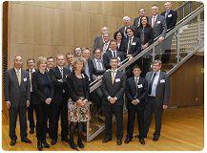


Key representation of WssTP members in EIP Water
High Level Steering Group
Task Force
14 representatives from WssTP members out of 45 Task Force members

Slide 28
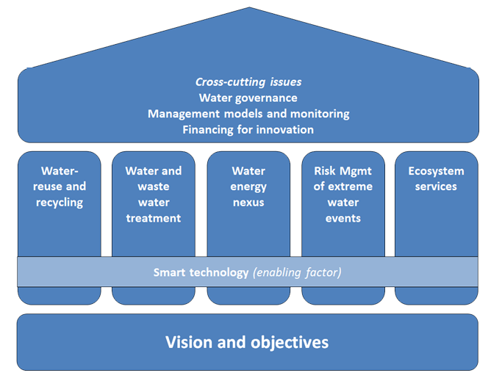
European Innovation Partnership on Water

Slide 29








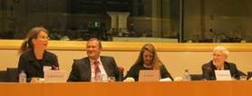







Some key Partners

Slide 30
Water sector coordination

Slide 31
WATER from FP7 to HORIZON
€130million per year in FP7
900 projects on Water from a multidisciplinary sectorial approach in FP7
A transdiciplinary and
cross-sectorial approach in HORIZON 2020
13th European Forum on Eco-innovation

Slide 32
WATER in HORIZON
SOCIETAL CHALLENGES 31.7 billion €
  Health, demographic change and wellbeing
  Food security, sustainable agriculture, marine and maritime research and the bioeconomy
  Secure, clean and efficient energy
  Smart, green and integrated transport
  Climate action, Resource Efficiency and Raw Materials
  Inclusive, innovative and secure societies
European Research Area
International cooperation
INDUSTRIAL LEADERSHIP 17.9 billion €
Leadership in enabling and industrial technologies (ICT, nano, materials, bio, manufacturing, space)
Access to risk finance
Innovation in SMEs
EXCELLENT SCIENCE 24.6 billion €
European Research Council
Future and Emerging Technologies
Marie Sklodowska Curie actions on skills, training and career development
Research infrastructures
Dissemination &
knowledge transfer
Simplified access
European Institute for Innovation and Technology
Joint Research Centre
Supporting EU policy priorities while enhancing synergies and cross-cutting competences
13th European Forum on Eco-innovation

Slide 33
Thank you
wsstp@wsstp.eu
www.wsstp.eu

