Slide 1





Portuguese Water Partnership (PWP)
Meeting with the
European Bank for Reconstruction and Development
“The Capabilities of the Portuguese Water Cluster”
Francisco Nunes Correia
President, Portuguese Water Partnership
London, 16th September 2013

Slide 2
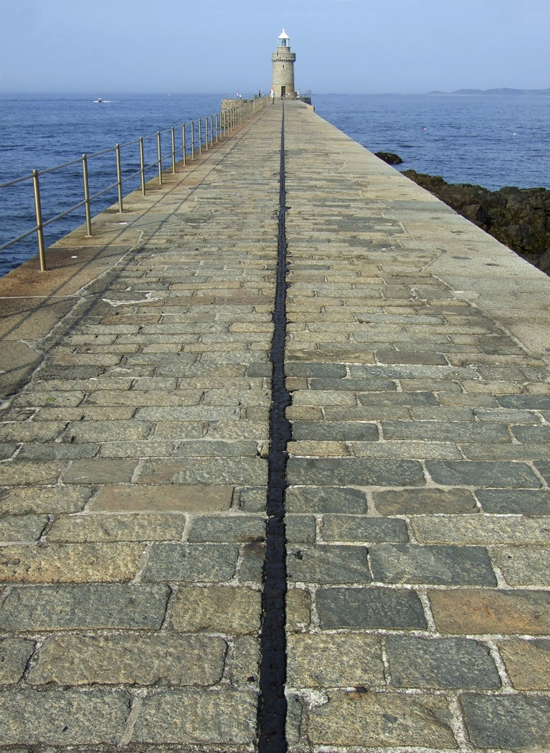
Background
Portugal has been for centuries a country open to the world
Globalization was a word first written in Portuguese in the 16th century. This attitude gives us a great motivation and openness for dealing with people and nations from all continents, regardless of their cultures and beliefs
This is exactly is what needed when addressing water issues:
A clear understanding that we face basically the same problems
with approaches that have been differently shaped throughout history

Slide 3
Vision
… but those different approaches aim at the same result:
sustainable provision of water for all uses,
at an affordable price,
managed by a fair system of governance.
Over the last 20 years there has been remarkable progress in the water sector in Portugal ...

Slide 4
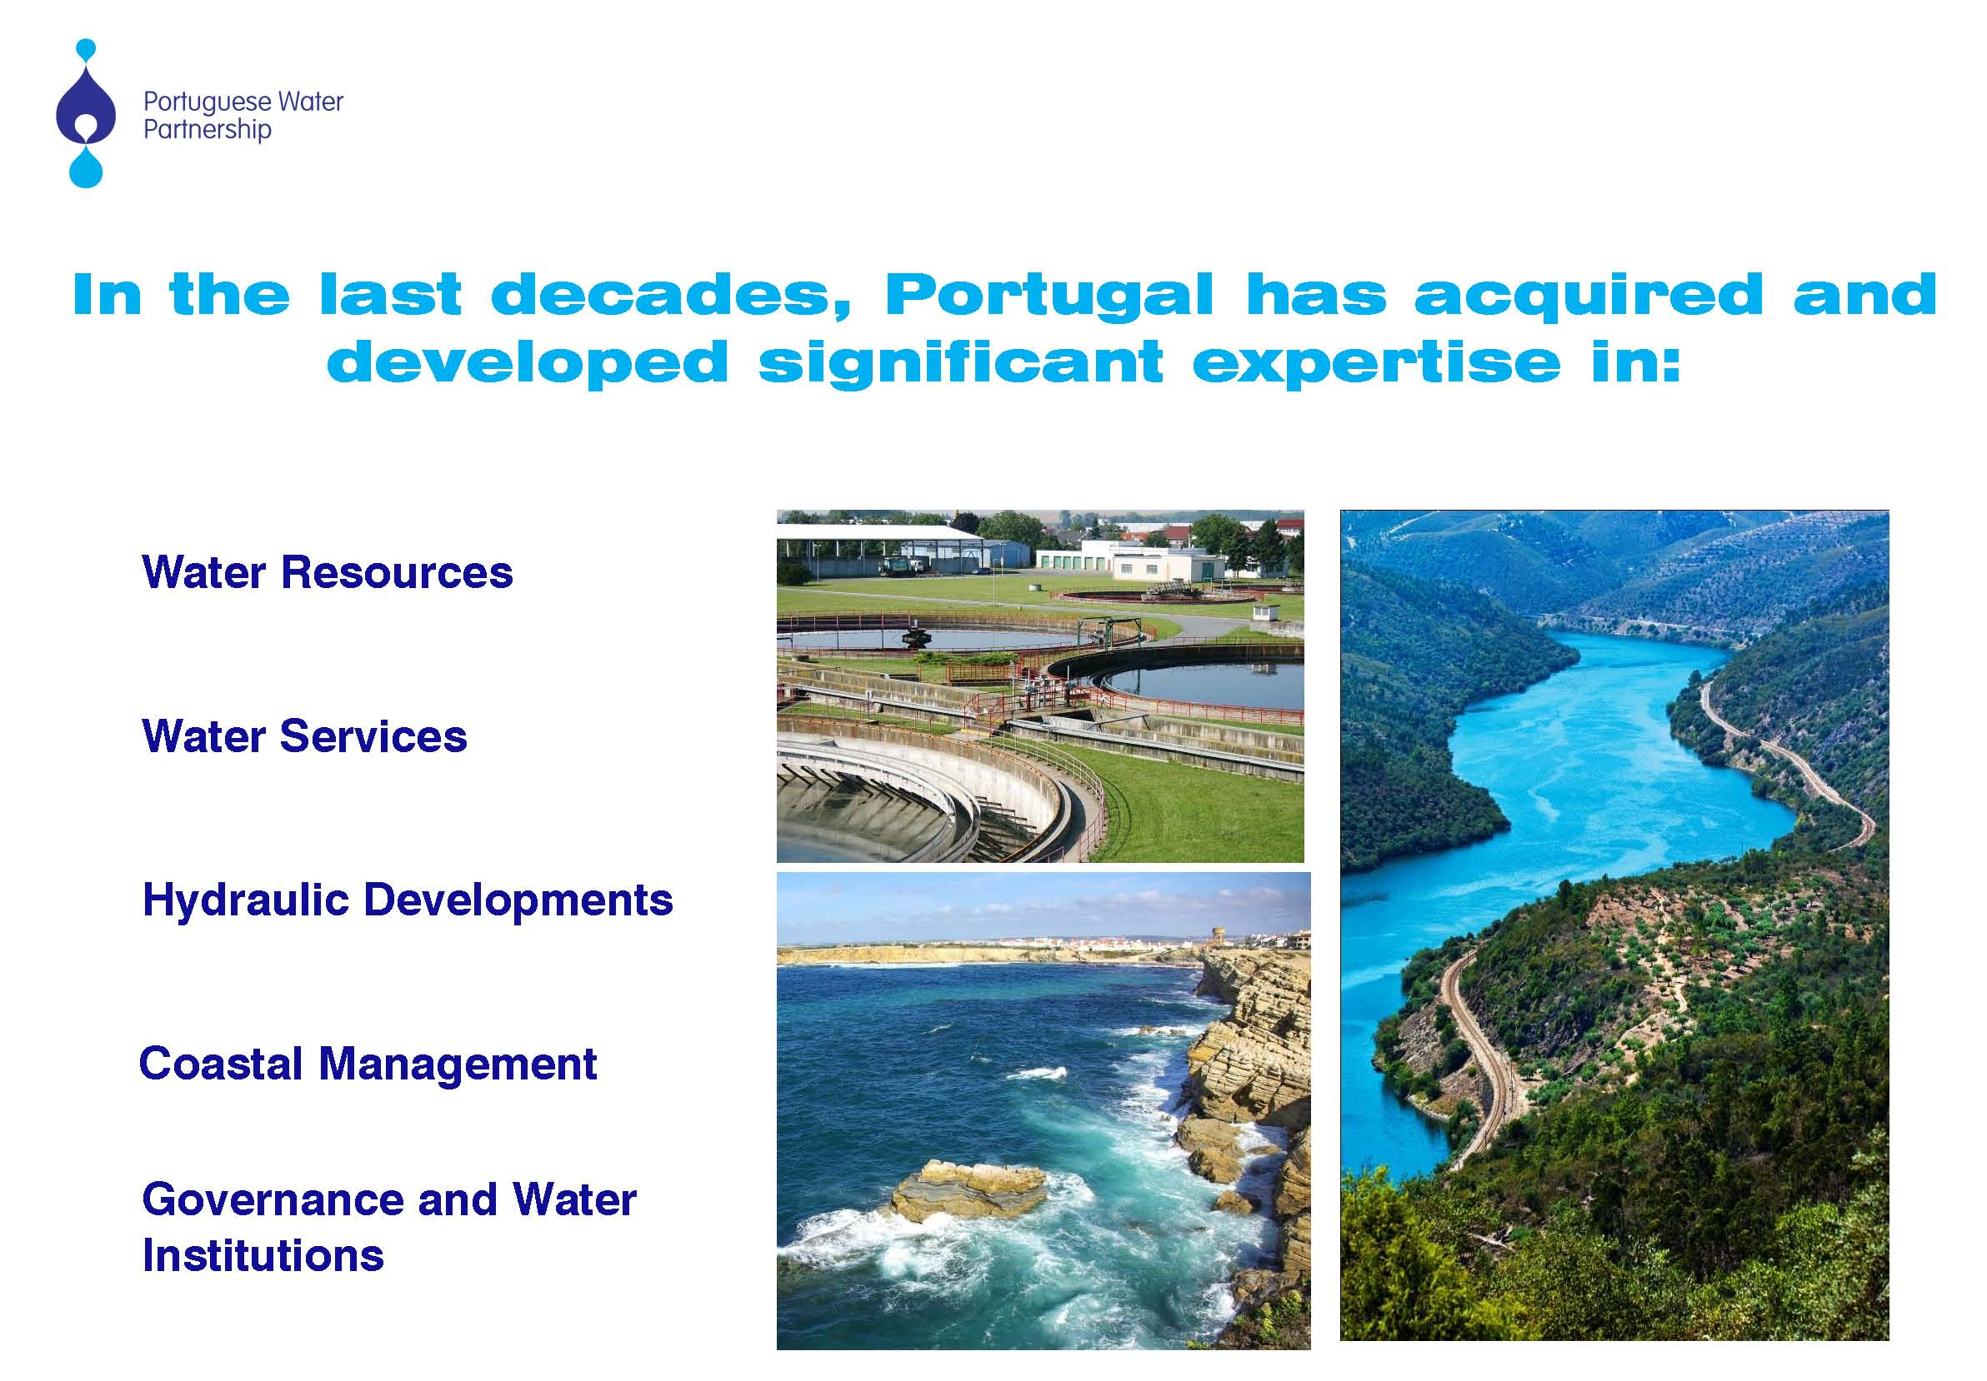
... resulting in the development of significant expertise and valuable competencies in:
Water Resources Planning
and Management
Water Services and
Regulation
Multi-Purpose Water
Systems
Water Institutions and
Governance

Slide 5
Water Resources Planning and Management
… a new and forward looking Water Law
… creation of five river basin authorities
… preparation of national and river basin plans
… a new flexible but strict licensing system
… a new economic regime for water use
… an environmentally friendly hydropower plan
… launching of several river restoration projects
… improvement of river agreements with Spain

Slide 6
Water Services and Regulation
… a medium and long-term strategy
… a consistent investment policy in the sector
… increasing scale through multi-municipal systems
… large scale public-public partnership
… an interesting “mix” of public and private
… much attention given to regulation
… financial sustainability of water systems
… state of the art technology
… a boom in service attendance (quantity & quality)

Slide 7
Water Institutions and Governance
… river basin councils with stakeholders
… easy access to administration
… flexible but rigoroud system of licensing
… widespread e-government practices
… creation of users’ associations
… partnership of central and local authorities
… delegation to municipalities and users

Slide 8


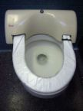
Evolution of the water sector in 1993-2012
and current targets
Percentage of the population with access to public water supply systems
80%
94%
95%
Quality controlled water supply in accordance with national and EU standards
50%
98%
99%
Population with access to public systems for waste water disposal with adequate treatment
30%
78%
90%

Slide 9



























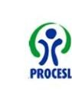

































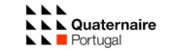
































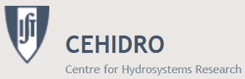


























This is the result of hard work and state of the art know-how of many enterprises and other institutions

Slide 10
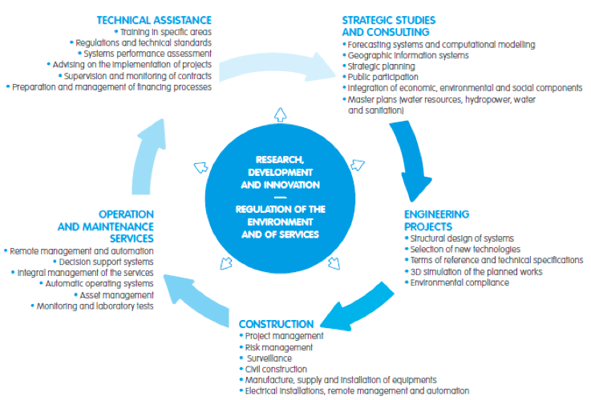
The Portuguese Water Partnership
covers the entire value chain
Serviços de Águas
Empreendimentos Hidráulicos
Gestão de Zonas Costeiras

Slide 11
Oportunidades de negócio
Oportunidades de negócio
PWP’s areas of geographic focus
“Virtuous triangle” and “emerging opportunities”
Portugal
Latin America
(Brazil, Mexico, Colombia, Chile, etc.)
Lusophone Africa (PALOP)
Magreb
Other African countries
Eastern Europe
China
India
Central Asia
Other Asian countries

Slide 12
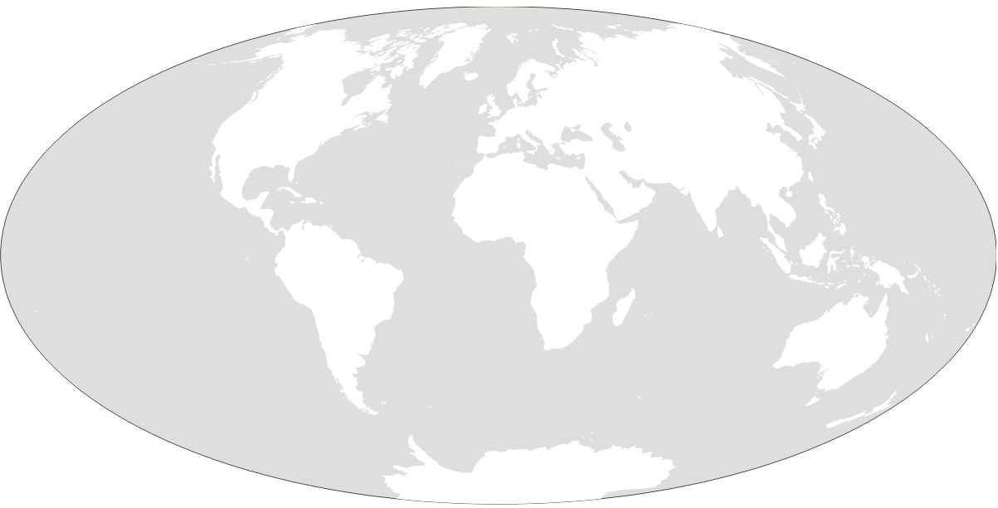
Significant focus on monitoring and sharing information on water international tenders…
Eurasia
35%
8%
MENA
20%
Asia
13%
28%
Latin
America
Sub-saaran
Africa
A total of 570 tenders in 2012…350 in first semester 2013

Slide 13











31%
20%
16%
12%
8%
5%
4%
2%
1%
1%

Slide 14
Some key initiatives ...
Concluded
6th WWF – Marseille
Morocco UNECE water appraisal
On-going
EU EIP on Water
CEWP – China Europe Water Platform
Planned
IWA 2012 – Busan
Business missions
Serbia
AfDB/ Tunisia
Mozambique
Acqualive Expo 2013
Angola Water & Energy 2013
Budapest Water Summit
IFAT 2014 - Munich
IWA 2014 – Lisbon Seminar with all water partnerships in the world
OECD Water Governance
AguaGlobal Project
… yet always seeking innovative ways of adding value to our members…

Slide 15
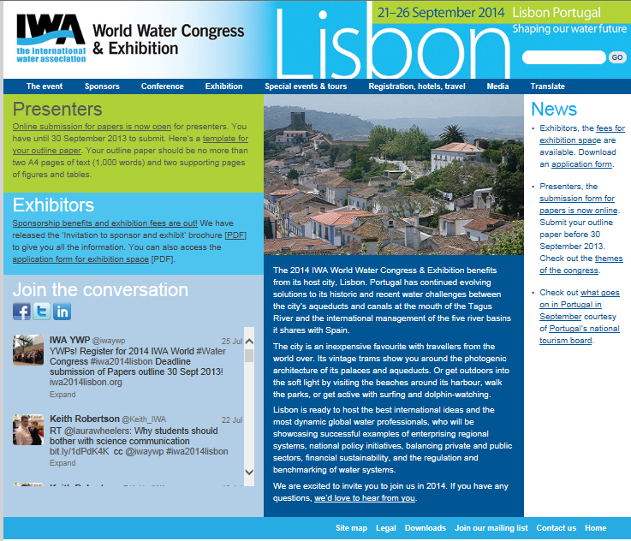

Slide 16

Whatever we possess becomes of double
value when we have the opportunity of sharing it with others
JEAN-NICOLAS BOUILLY (1763-1842)
Whatever we possess becomes of double
value when we have the opportunity of sharing it with others !
JEAN-NICOLAS BOUILLY (1763-1842)

Slide 17
Contacts:
In Lisbon:
Prof. Francisco Nunes Correia
President
E-mail: fnc@civil.ist.utl.pt
Dr. João Simão Pires
Executive Director
Centro Empresarial Torres de Lisboa
Rua Tomás da Fonseca, Torre G – 7º
1600-209 Lisboa
Tel.: (+351) 210052209
E-mail: jsp.ppa@ersar.pt
In Oporto:
Edifício de Serviços (a/c AEP)
Av. Dr. António Macedo
4450-617 Leça da Palmeira

Slide 18

Portuguese Water Partnership
Thank you !
um contributo português para o desenvolvimento do sector da Água no Mundo
24 de Setembro 2009
Whatever we possess becomes of double value when we have the opportunity of sharing it with others. BOILLY

